Slide 1
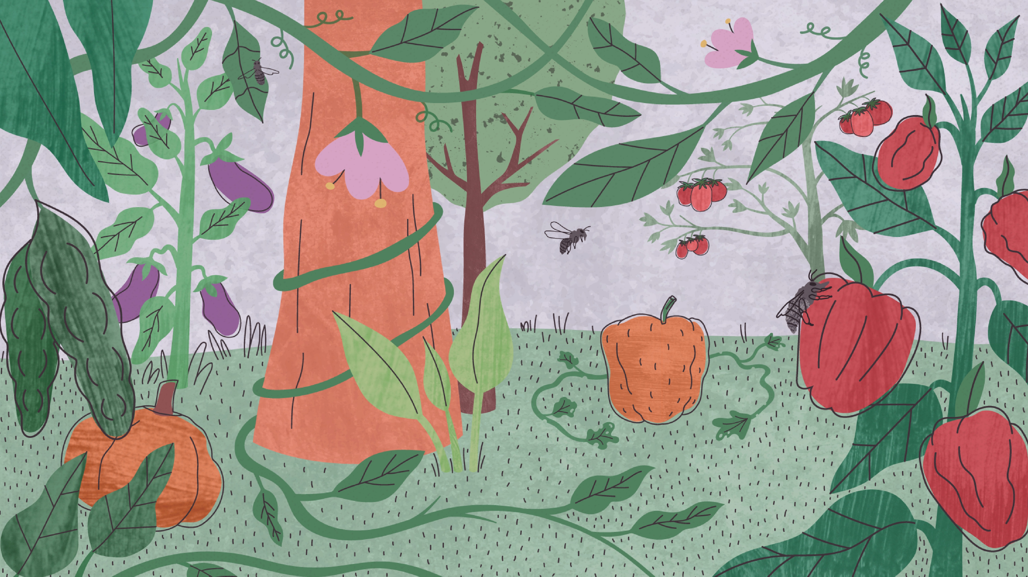

Food
gbif.org/food

Slide 2
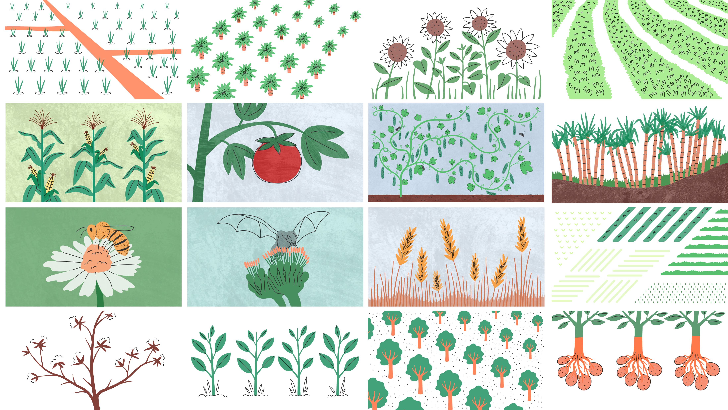
Food
gbif.org/food
Notes:
Text from postcard:
Research and policy on food security uses GBIF-mediated biodiversity data to identify key areas for crop wild relatives, boost resilience to agricultural pests, and reveal critical trends for wild pollinators.

Slide 3
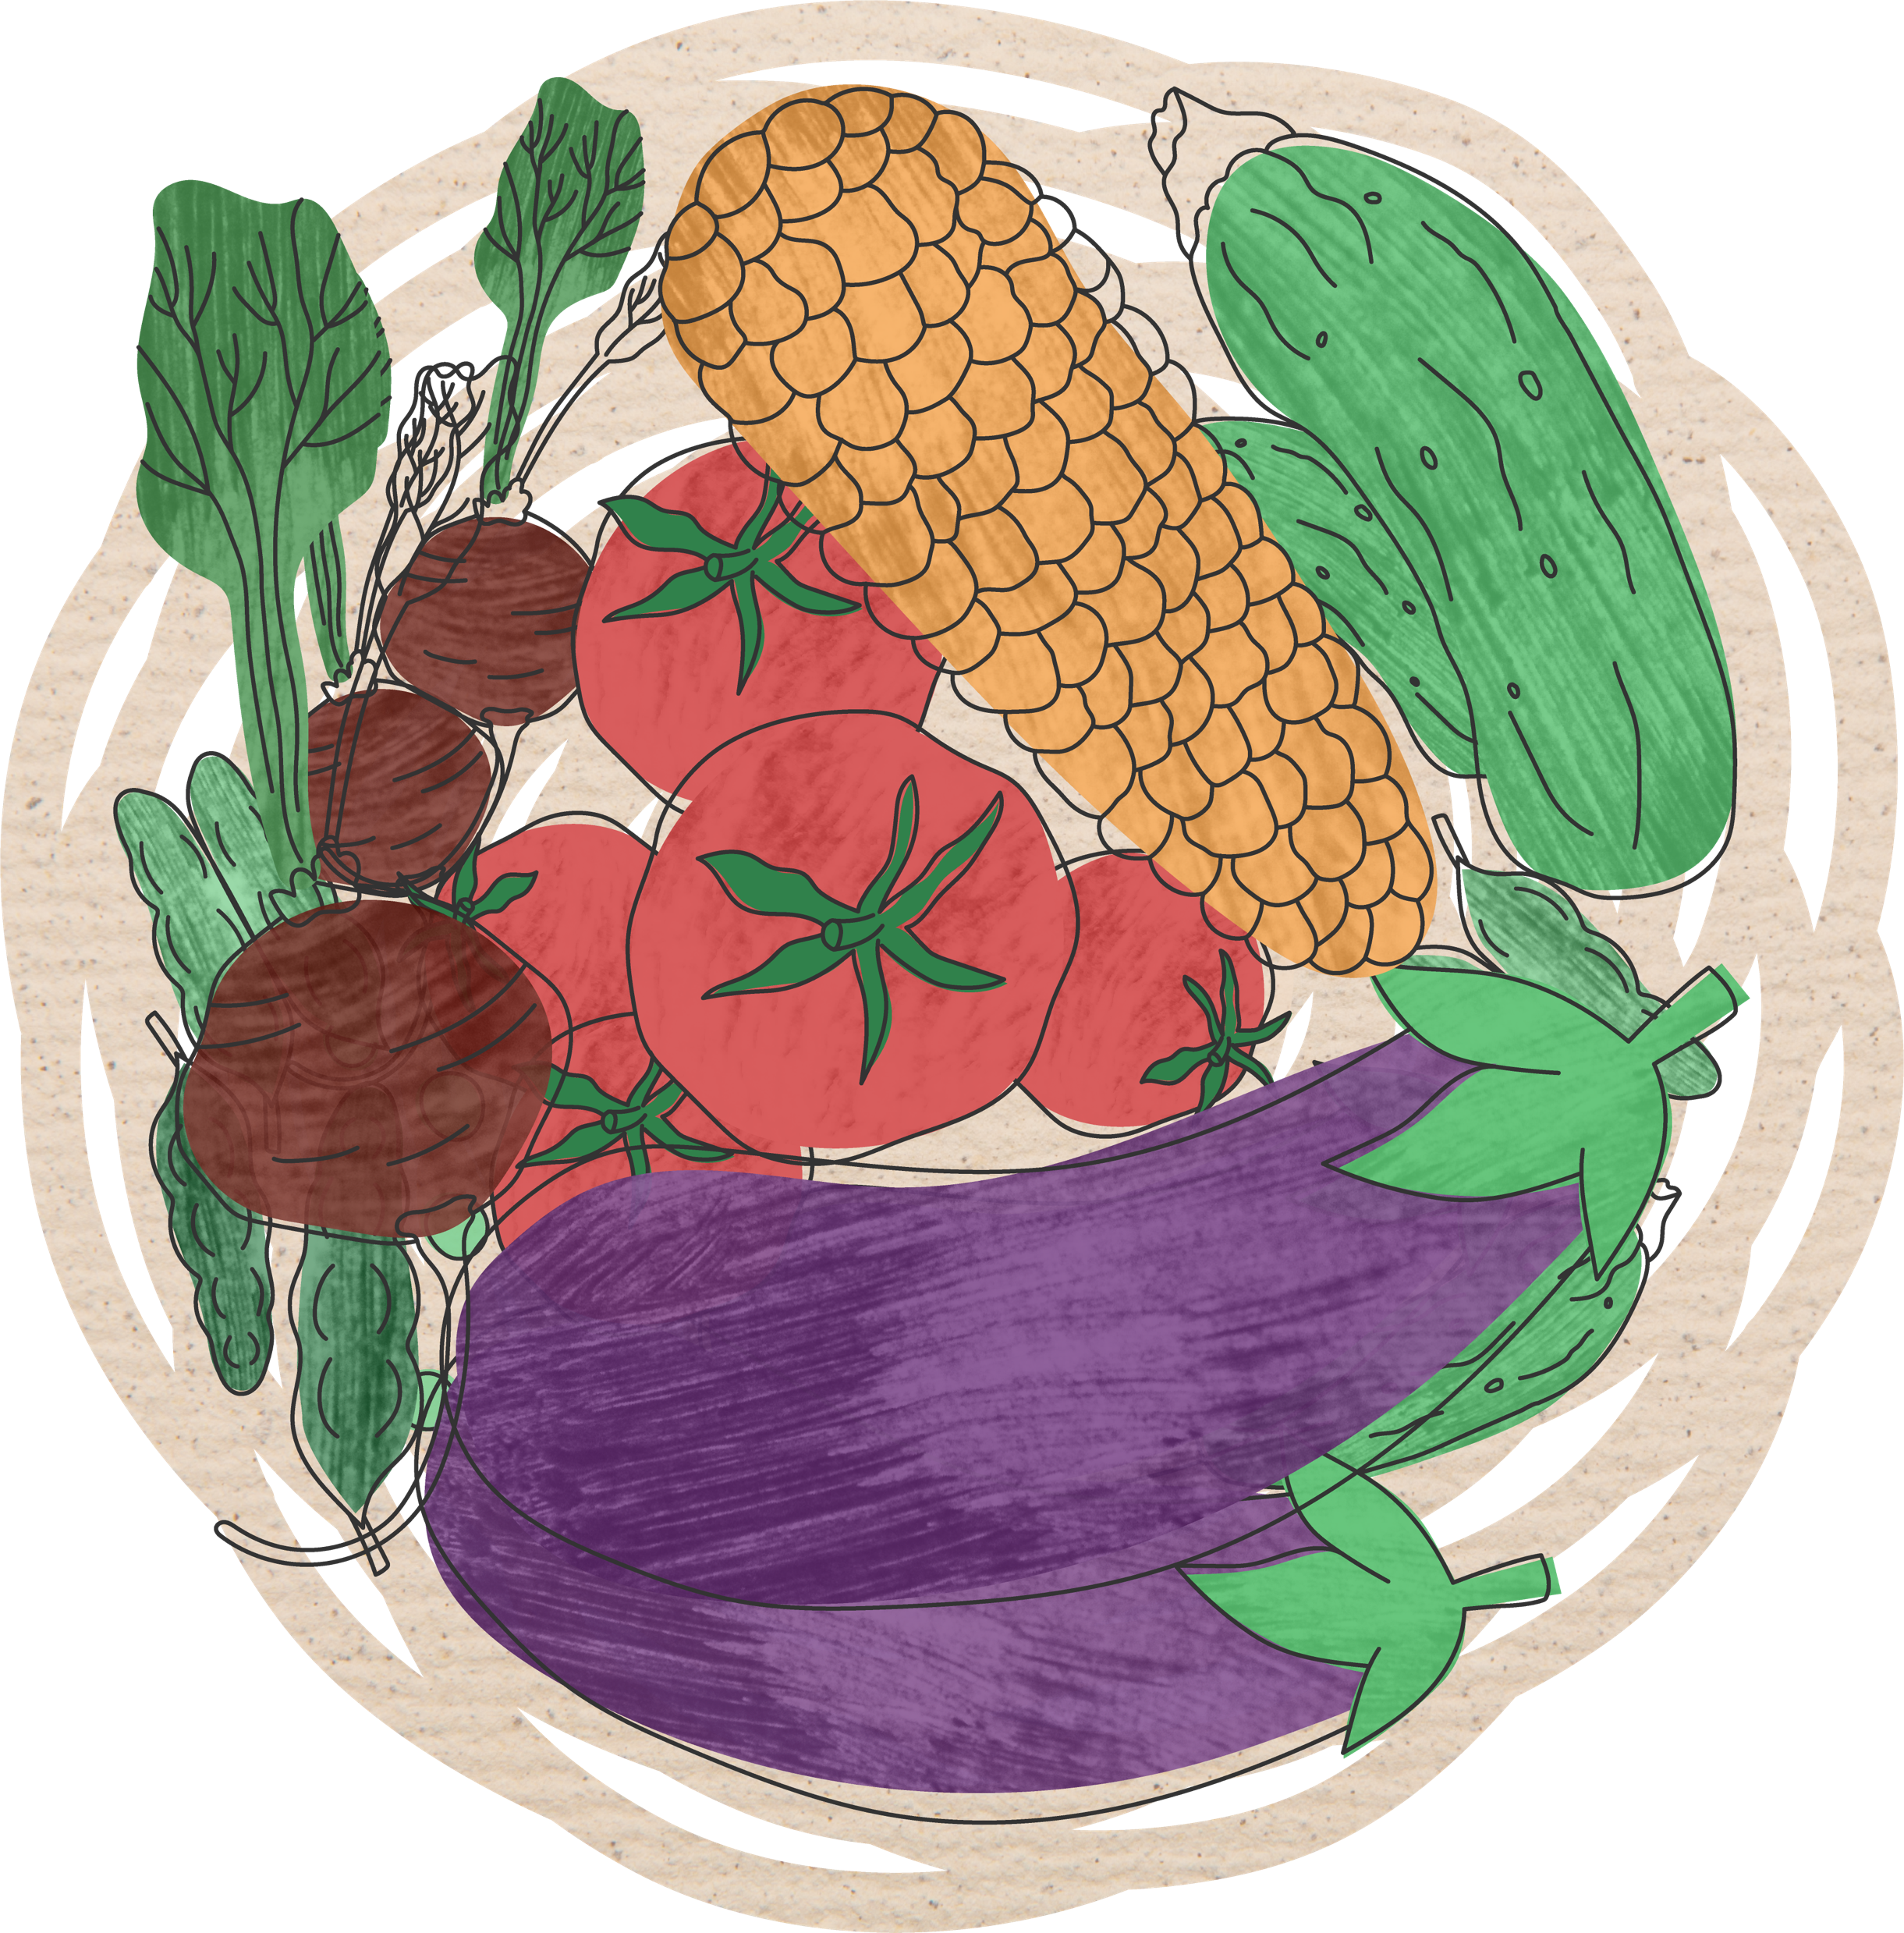
Food
GBIF mediated-data is crucial to improve food security and agricultural policy by helping to identify areas for agrobiodiversity crop wild relatives.
gbif.org/food
Notes:
Notes

Slide 4
Food
Data from the GBIF network preserves and contributes to various dimensions of knowledge, research and policy in agriculture and food security.
Much of this work focuses on the relationships betweeen domesticated crops and their wild relatives, or crop wild relatives, and how they can shape and inform farming practices in the face of global climate change. The protection of wild species can improve food security and agricultural policy by increasing crop yields and making cultivated species more adaptable and resilient, free from pests and pathogens, and better able to adapt to changes in temperatures or precipitation.
Combining climate, soil, and other data with GBIF-mediated data also helps identify changes in regions suitable for different crops in future, high-risk areas for agricultural pests, possible benefits and risks of biofuel production, and relationships and interactions between pollinators.
gbif.org/food

Slide 5
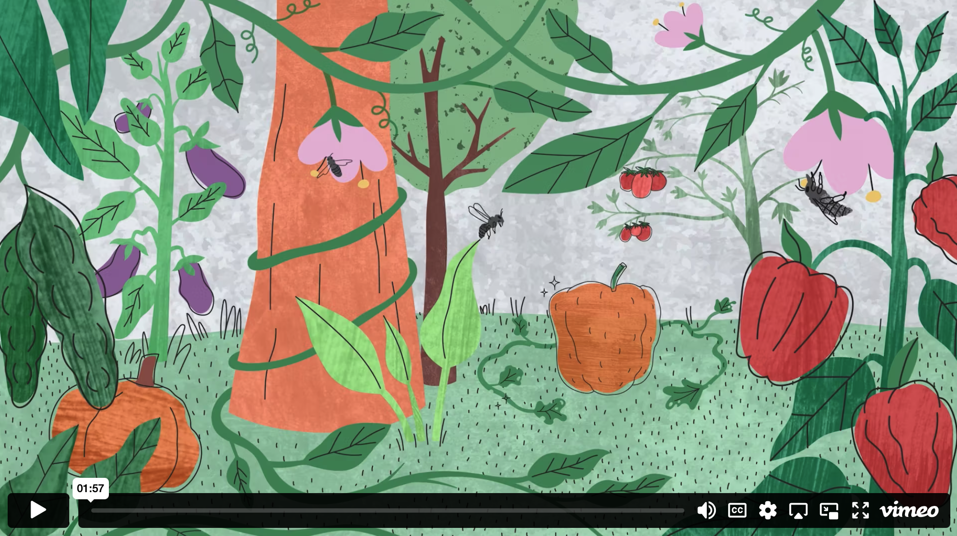
GBIF & food - Video

Slide 6
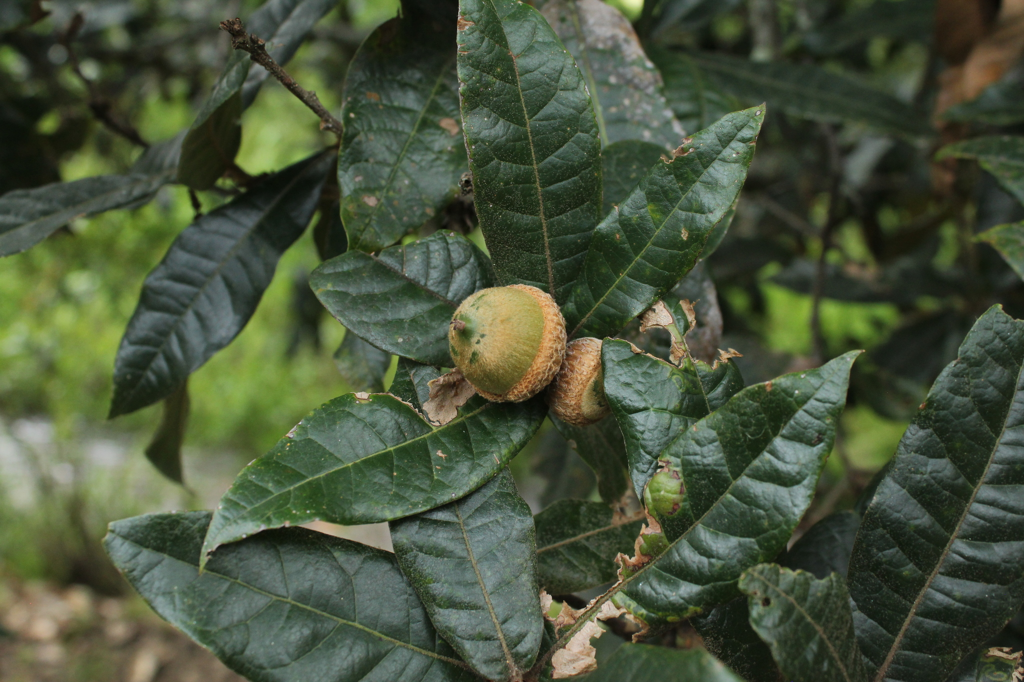

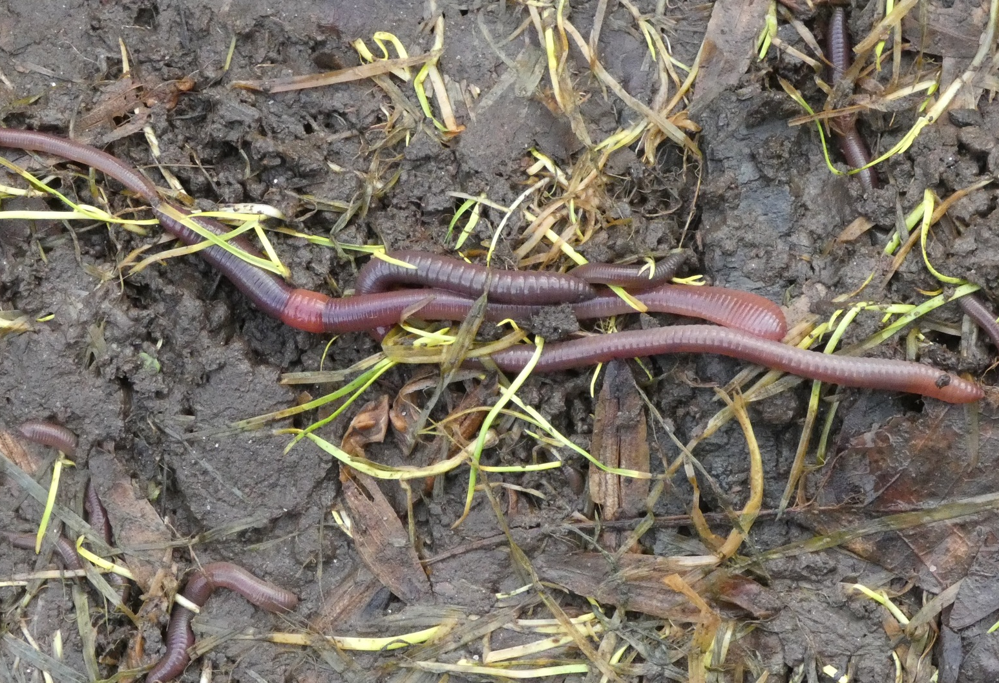
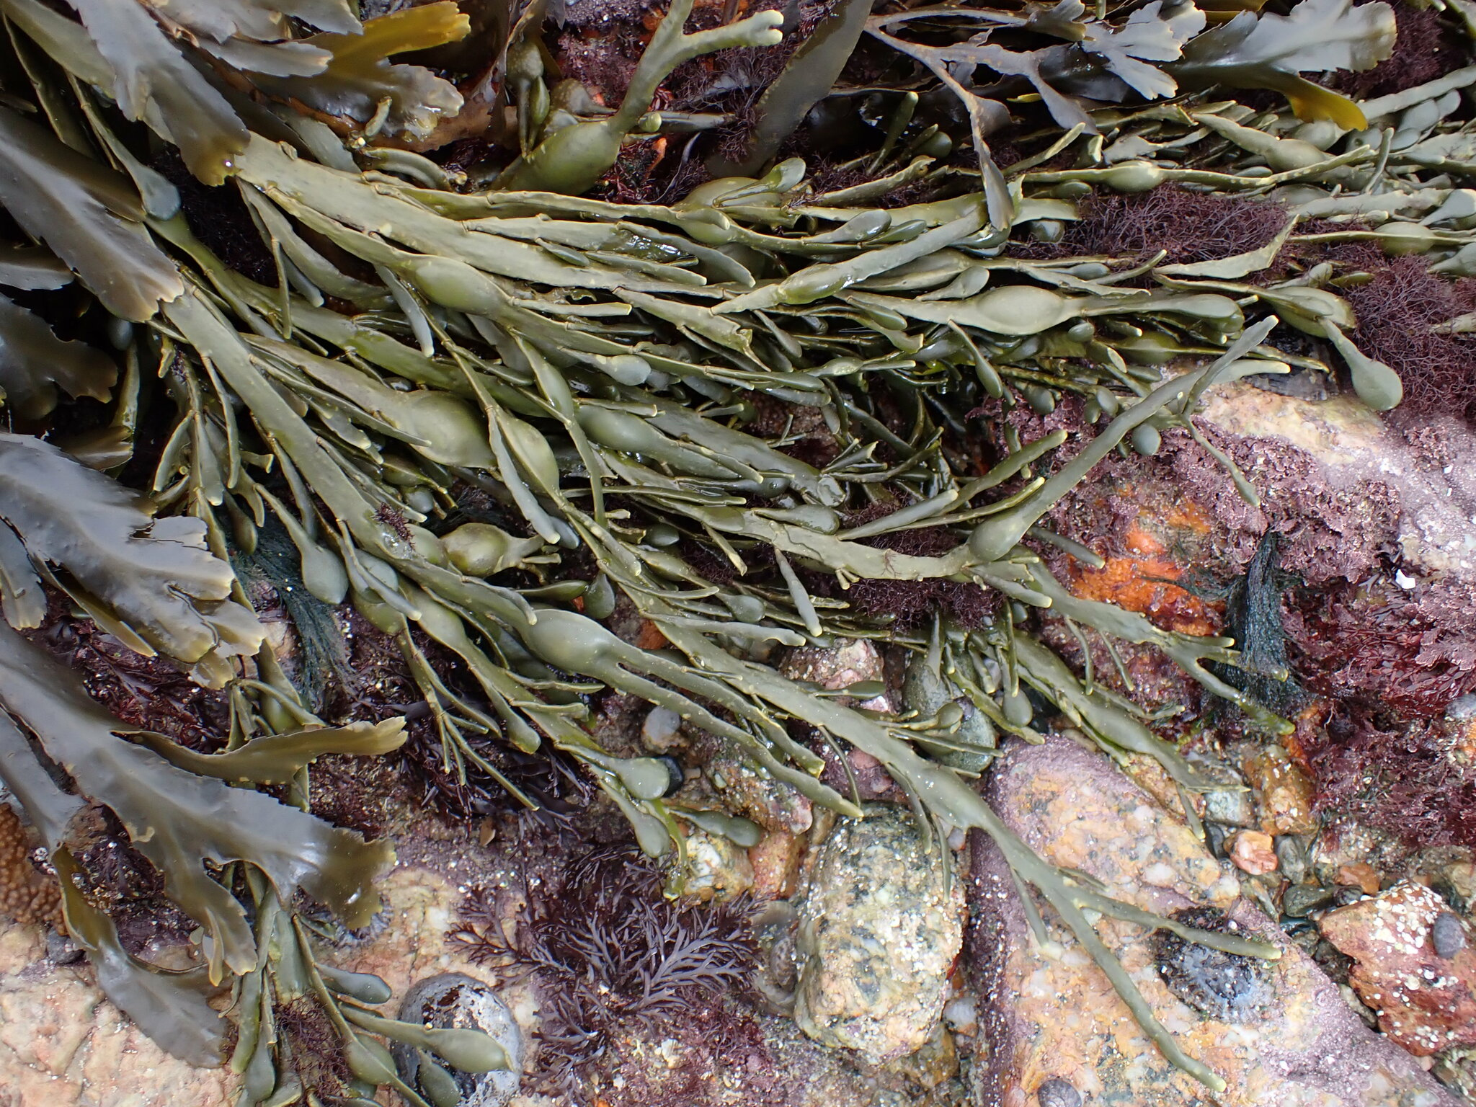
Featured data uses in food-related research
Diversity and distribution of edible plants in Colombia
Extinction risk of Mesoamerican crop wild relatives
Using soil hydromechanics to predict global earthworm distribution
Farming seaweed to feed, power and save the planet
https://www.gbif.org/resource/search?q=food&contentType=dataUse&topics=AGRICULTURE
Notes:
Notes

Slide 7
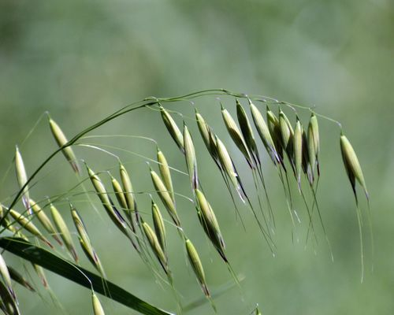
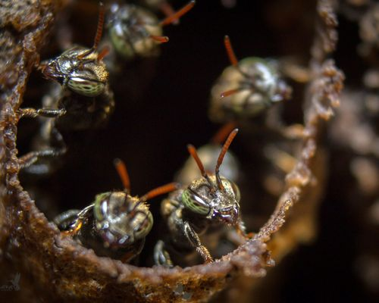
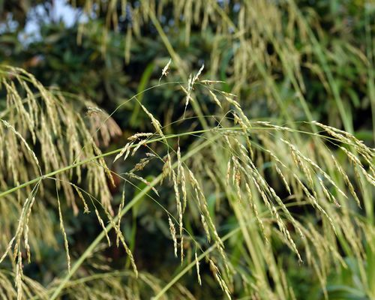
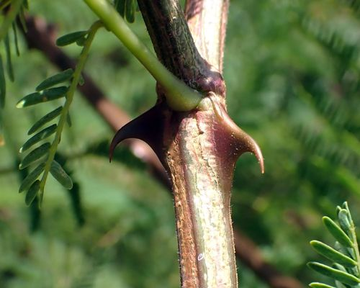
Featured datasets and publishers related to food security and agriculture
A global database for the distributions of crop wild relatives
Bee Biology and Systematics Laboratory
Malawi Plant Genetic Resources Centre (MPGRC)
Categorization of the wild food plants and their importance for primate development in the natural forest of Akpe (Lama) in southern Benin.
gbif.org/food
Notes:
Notes

Slide 8
Food
Learn more!
gbif.org/food

